Slide 1

CV DEVELOPES
THIRD YEAR CSE. GUIDE.
S.T.ABISHEAK ,950020104704. DR.FAREENA
D.RAGHUVARAN,950020104032. ASSISTANT PROFESSOR
CSE DEPARTMENT
ANNA UNIVERSITY REGIONAL CAMPUS -TIRUNELVELI

Slide 2
INTRODUCTION
MAKING RESUME GENERATION SIMPLER
HIGH SECURITY OF DATA STORAGE AND UPDATION OF DATA
HAVING VARIOUS FONTS AND TEMPLATE FOR RESUME GENERATION
TO REDUCE THE WRITTEN WORK AND REDUCE HARDCOPY
TO AVOID THE MISSING OF RESUME DOCUMENT

Slide 3
OBJECTIVE
EASIER TO ACCESS RESUME
TO MAKE RESUME ATTRACTIVE WITH PHOTO
HIGH SECURITY OF DATA
DOWNLOAD IN EASY WAY

Slide 4
ABSTRACT
IT HAS A MANDATORY STATUS AND DETAILS WANT TO BE FILL IN THE RESUME
IT HAS A OPTION TO TAKE A RESUME WITH PHOTO
IT HAS A EASY WAY TO TAKE YOUR RESUME BY GIVING USERNAME AND PASSWORD

Slide 5
LITERATURE SURVEY
The CV is a self report and, as such, may be economical with the truth or contain exaggerations and even complete fabrication. Applicants know the importance of their résumé, which may get only a few seconds of attention before is rejected, and so may take inordinate care over their construction.
Bharti Kungwani, Amisha Manglani, Naman Dembal, Hiten Hirani, Laveen Sawlani, “Analytical Resume Builder – A web Application for Creating a resume which gives a best impact in this competitive world”,which provides precise knowledge and analyzed stats. In addition, it provides resumes of graduates i.e., placed students. So, the users will get more clarity on their resume. Furthermore, it also informs about upcoming company drives and campus placements. The application uses statistical analysis by collecting quantitative data and then represents it in a visual format. After the successful building of the resume user can export the file in PDF format.

Slide 6
LITERATURE SURVEY
2.Prof. Gauri R Rao, Ms. Renuka S Anami “Automated
Profile Extraction and Classification”. The author says,
we are investigating the issues related to the
development of approaches to improve the performance
of resume selection process.
3. Prof. Satish L. Thombare, Ms. Shweta V. Raja
“Automated Resume Extraction and Candidate Selection
System”.The author says,we collected the resumes from
the students of various courses applying for a job.
Students applying for the job will send the resumes in
different formats (doc., docx, pdf, text, etc.)

Slide 7
SYSTEM REQUIREMENTS
Architecture
Client –Server Architecture
HARDWARE
INTEL I3 /AMD RYZEN 3 PROCESSOR
2GB RAM
SOFTWARE
VISUAL STUDIOS CODE

Slide 8
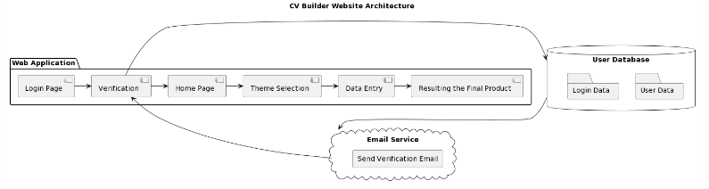
System design
Architecture

Slide 9
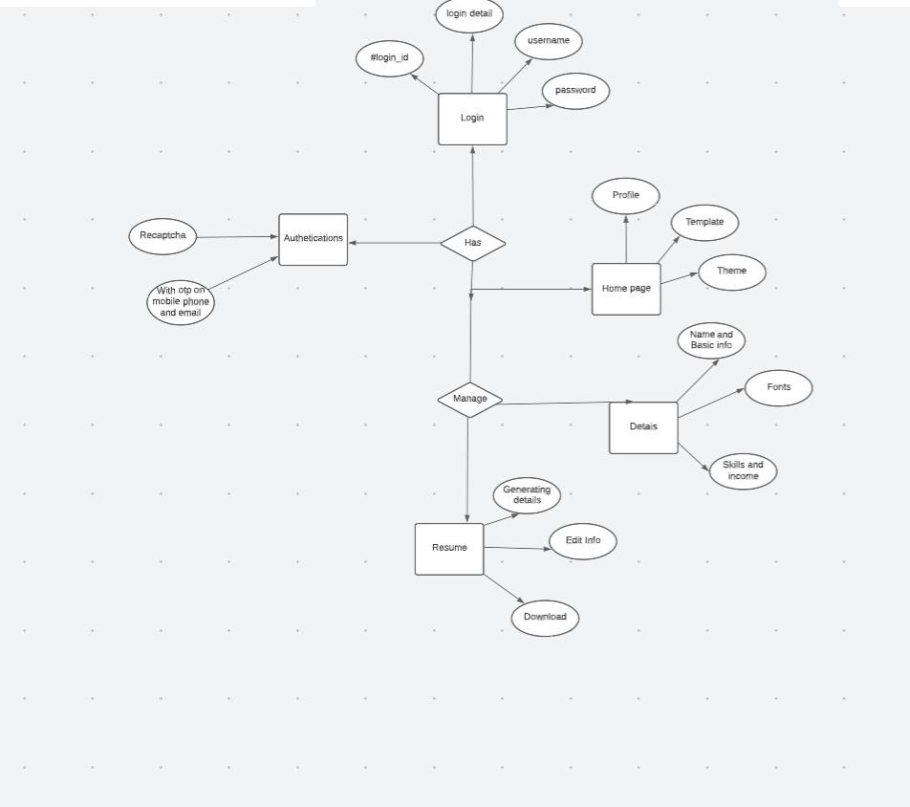
UML diagram
Entity relationship diagram

Slide 10
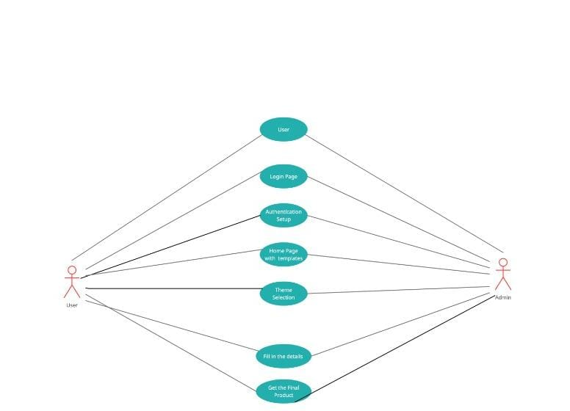
Use case

Slide 11
Data flow diagram
Download the CV in Various Format
Level-0
Login Management
Online
Resume Builder
Data Entry
Authentication and
Security
Theme Management
Home Page Management

Slide 12
Data flow diagram
Question Management
Level-1
Login Management
Data Entry
Security
Online
Resume Builder
Home Page
Resume Management
Theme
Seletion
Skill
Management
Generate Resume Report
System User Management

Slide 13
Data Flow Diagram
Manage Resume Details
Level 2
Manage Job Details
Login to system
Check
Roles
of
Access
Admin
Manage Skills Details
Manage Jobskeer Details
Forget Password
Check
Credentiais
Manage
Moduie
Manage Salary Details
Send details to contact info
Manage User Profiles
Manage
Manage System Admins
Manage Roles of User
Manage User Permission
Manage Report

Slide 14
MODULE DESCRIPTION 1
CREATION OF CV BUILDER
FIRST WE HAVE BUILT A ONLINE RESUME BUILDER USING HTML,CSS AND JAVASCRIPT.
WE HAVE CREATED FOUR THEMES WITH DIFFERENT FONTS .
ALONG WITH THAT WE HAVE MENTION A MANDATORY FORM FOR FILLUP DETAILS .

Slide 15
MODULE DESCRIPTION 2
CREATING A HOMEPAGE
WE HAD LOGIN PAGE WITH USERNAME AND PASSWORD.
ALONG WITH THAT WE HAVE AUTHENTICATION SYSTEM TO GET THE USER TO BE SECURED WE ARE GETTING OTP FOR USER SECURITY.

Slide 16
MODULE DESCRIPTION 3
CHOOSING THEMES AND COLLECT THE FILE
WE ARE HAVING HOMEPAGE WITH VARIOUS CV BUILDER THEME AND BUILDER WILL BE CONNECTED.
ALONG WITH THAT WE HAVE FIREBASE SYSTEM TO GET THE USER DATA COLLECTED AND WE ARE DOWNLOADING A FILE USING BLOB.

Slide 17
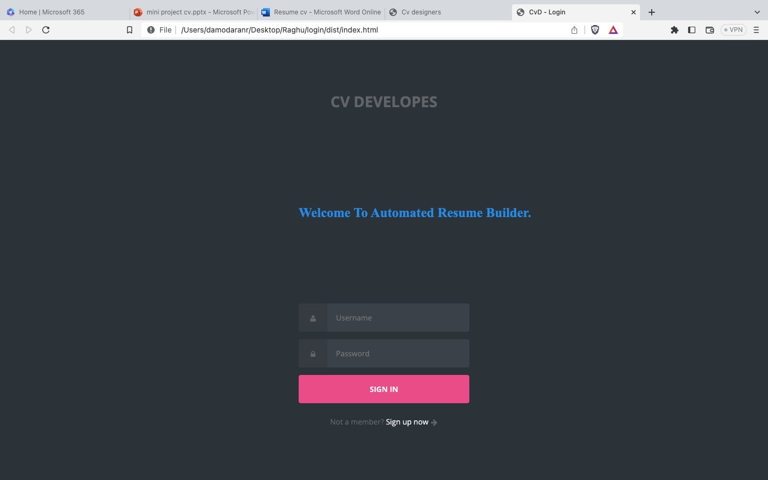
40%project completion 1.Login page

Slide 18
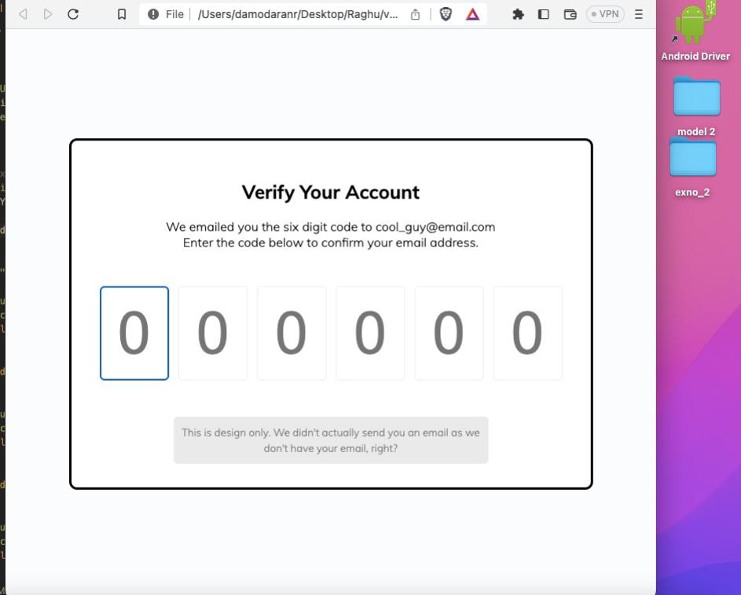
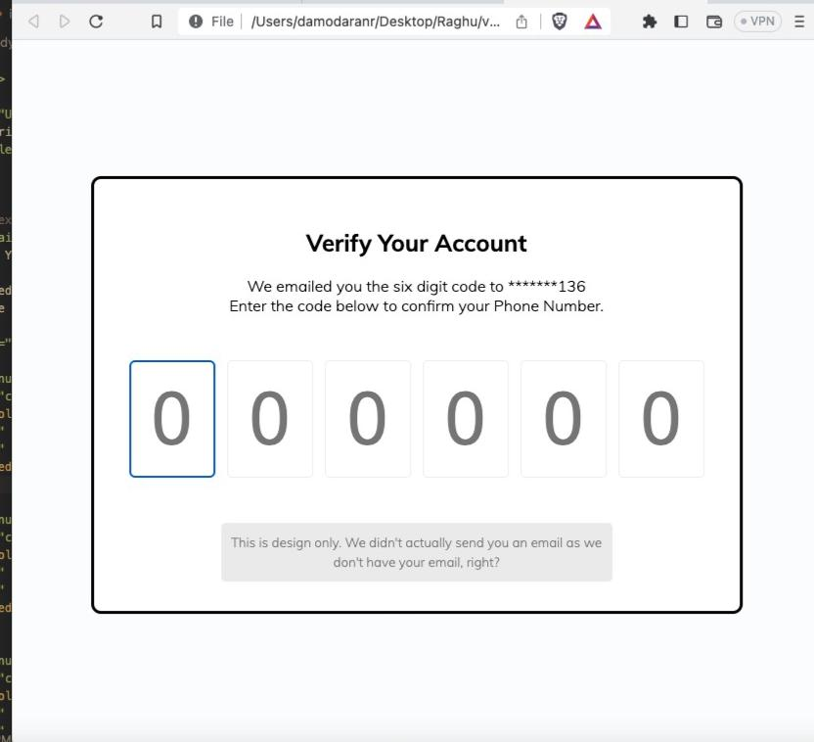
2.verification using email id and phone number

Slide 19
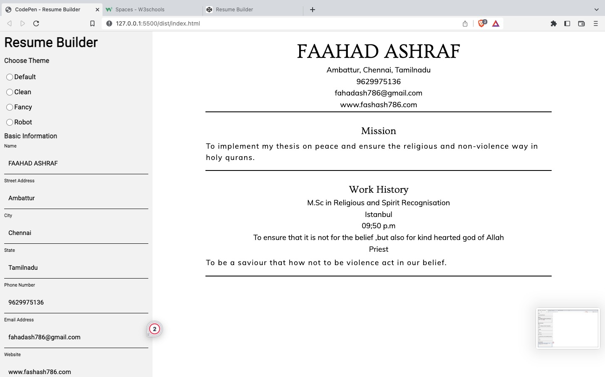
3.CV builder

Slide 20
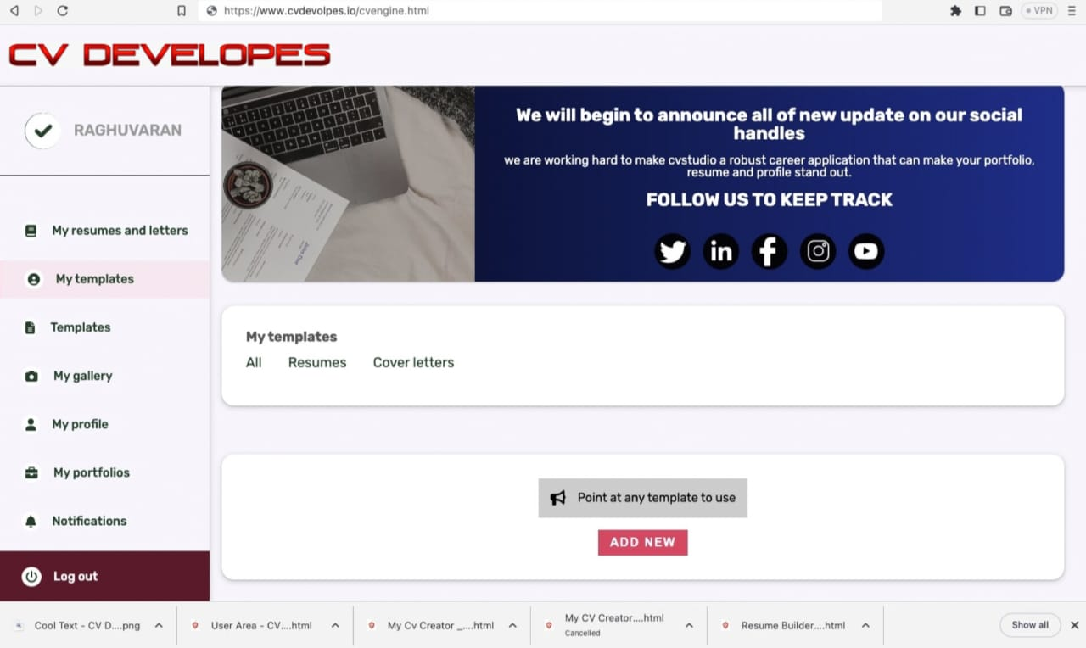
3.Theme selection

Slide 21
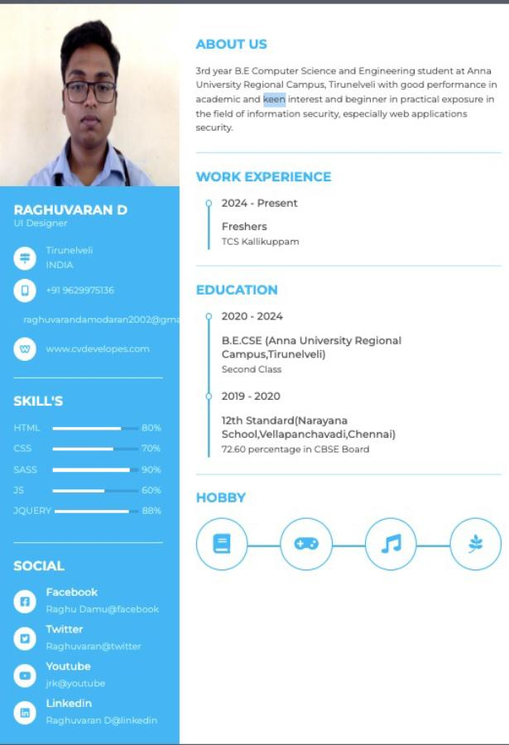
4.Finally resume download

Slide 22
SUMMARY
This resume is for the college freshers,business personalities and time consumers.
First we have the authentication for the websites and then we have different types of themes.
We have a home page for different themes and we have different fonts.
Finally, we can download the file it increases the chance of job seekers to get their dream job.

Slide 23
References
We have referred this website from Github.
We have get referred in other websites such as Canvas,Wix and onlinecvresume.com
Tutorialpoint website
W3school website
Wppathfinder and Developer Filip in youtube channels.

